Slide 1


FUNDING FOR KANSAS ENTREPRENEURS
ROBERT WILSON
Product Manager | Rural Entrepreneurship | Northeast Region
Network Kansas
City of Leavenworth Business Symposium
October 23, 2023

Slide 2


Leavenworth County
E-Community PARTNERSHIP
Capital | Connections | Community

Slide 3
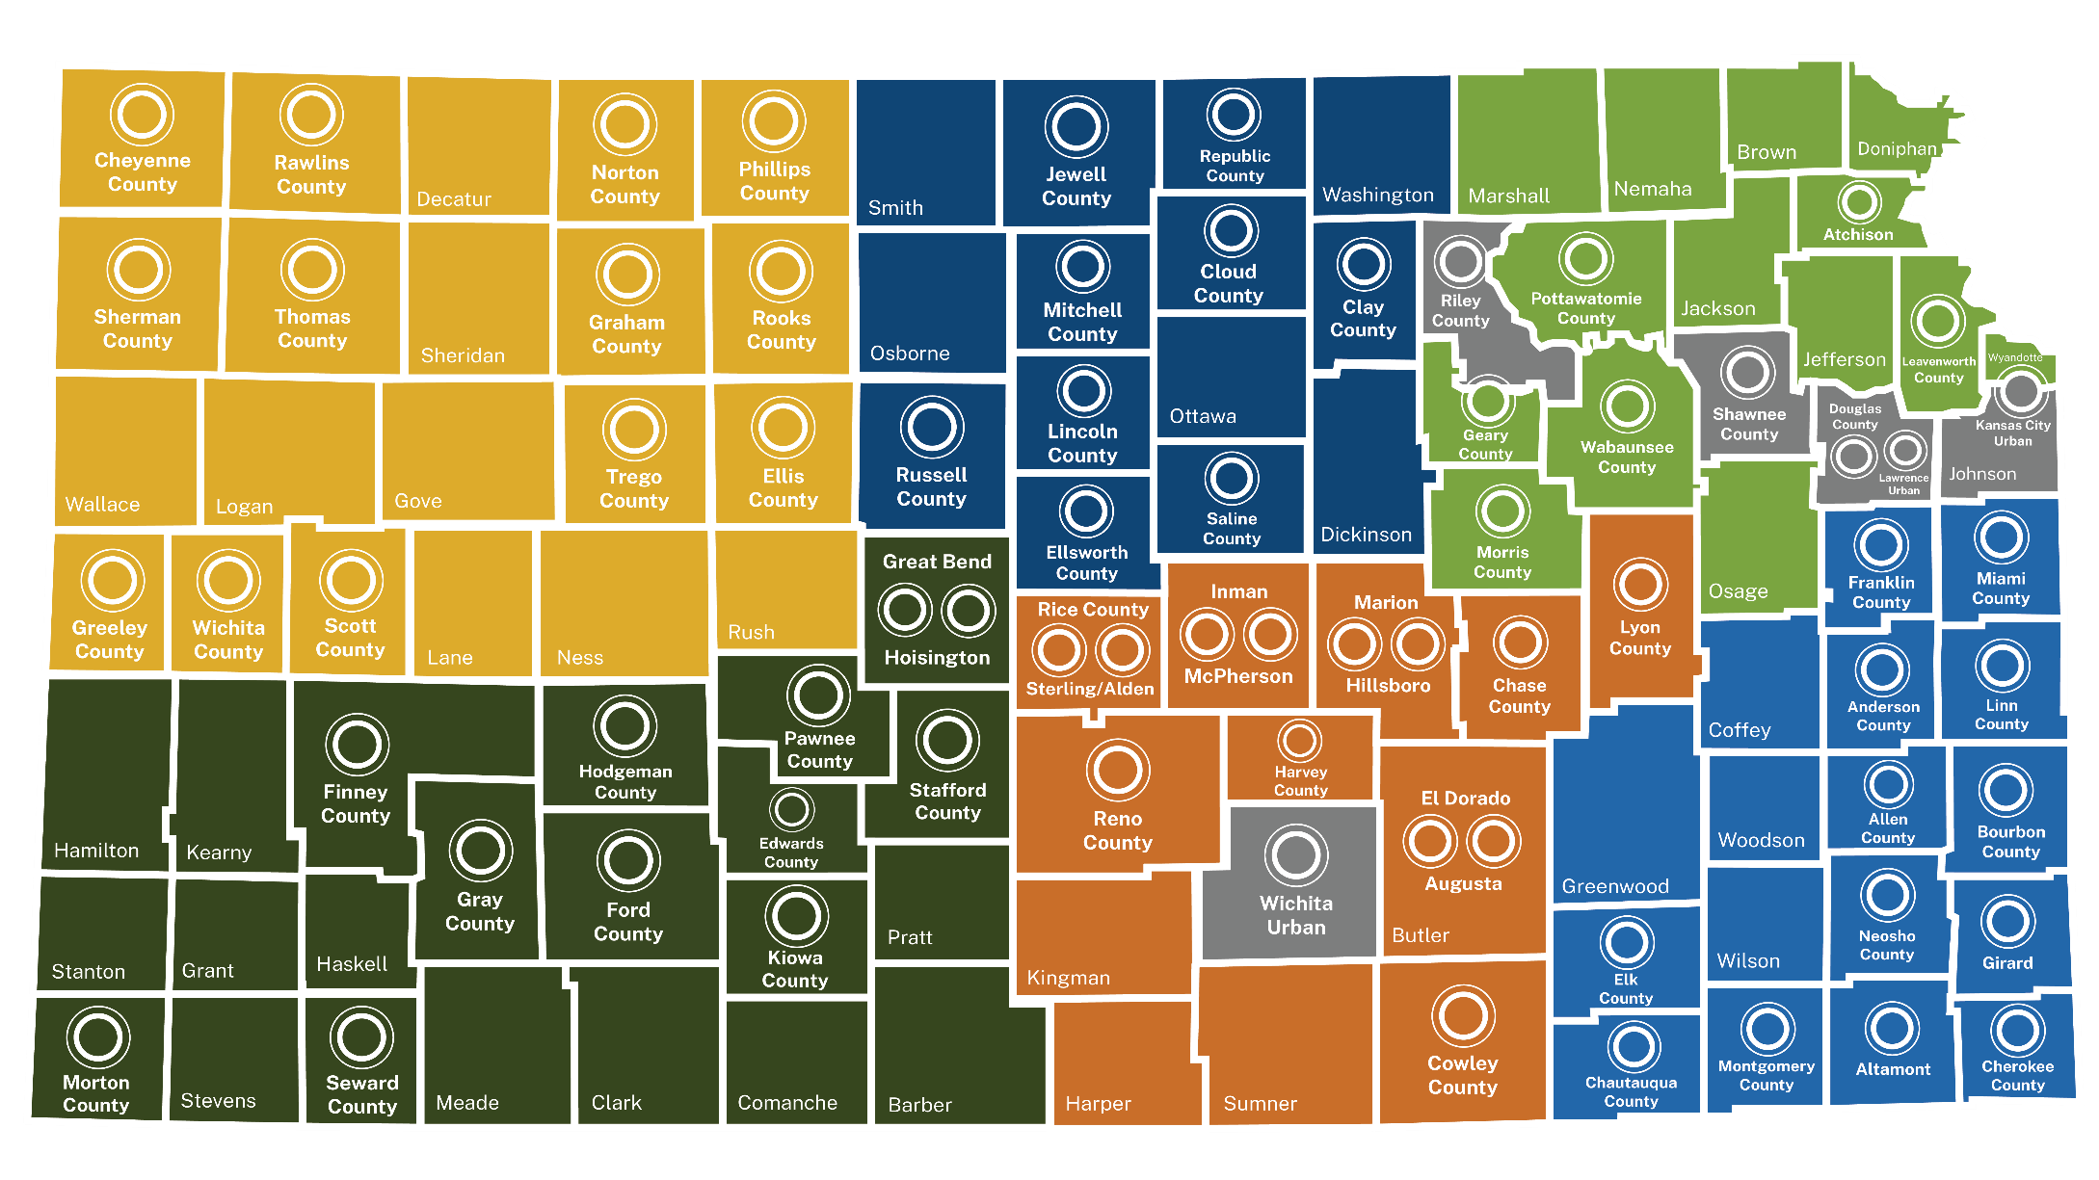
E-Communities in Kansas
Notes:
E- Community Update/Background

Slide 4


E-Community Loans
Start, purchase, or expand a for-profit business
Applicant must be a legal entity
Located within e-community
Private and/or public funding required
Flexible use of funds: working capital, inventory, real estate, equipment, etc.
Match: 150% of private/public funding
Max loan: $45,000
Cannot exceed 60% of total project cost
Min Loan Terms: 1-5 years 3%
6-10 years 4%
Notes:
TIFFANY

Slide 5

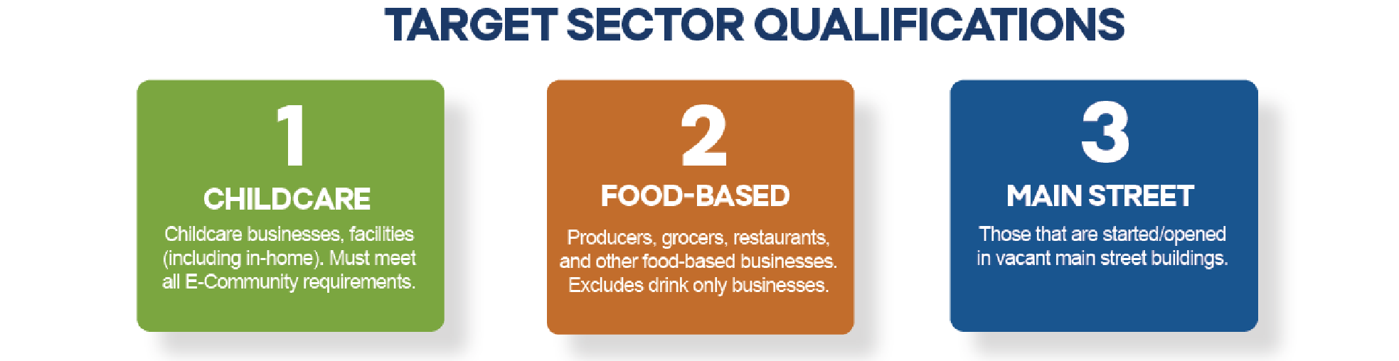
Grant Amount: 30% of E-Community Loan
Loan + Grant cannot exceed 60% of total project cost
Maximum Loan + Grant: $45,000
Notes:
JENN

Slide 6



Companion Funding to Bank Loans
MINORITY/WOMEN-LED STARTER LOANS
MINORITY/WOMEN-LED GROWTH LOANS
RURAL/URBAN DISTRESSED LOANS
COMMUNITY ASSET LOANS
TARGET SECTOR LOANS
growks.com/loans
Notes:
TIFFANY

Slide 7
Companion Funding to Bank Loans
MINORITY/WOMEN-LED STARTER LOANS
Match: 200% of private investment
Geography: Statewide
Loan Cap: $100,000
Example:
$50,000 Bank Loan
$100,000 Minority/Women-Led Starter Loan
growks.com/loans
Notes:
TIFFANY

Slide 8
Companion Funding to Bank Loans
MINORITY/WOMEN-LED
GROWTH LOANS
Match: 25% of private investment
Geography: Statewide
Loan Cap: $250,000
Example:
$1,150,000 Bank Loan
$125,000 Minority/Women-Led Growth Loan
growks.com/loans
Notes:
TIFFANY

Slide 9
Companion Funding to Bank Loans
RURAL/URBAN DISTRESSED LOANS
Match: 150% of private investment
Geography: Rural & distressed areas
of urban centers
Loan Cap: $100,000
growks.com/loans
Example:
$450K Bank Loan
$100,000 Rural/Urban Distressed Loan
Notes:
TIFFANY

Slide 10
Companion Funding to Bank Loans
COMMUNITY ASSET LOANS
Access to Care, Education, Healthy Behaviors
Civic Engagement
Provide Economic Benefits to Community
Match: 15% match of private investment
Geography: Statewide
Loan Cap: $250,000
growks.com/loans
Example:
$1,300,000 Bank Loan
$200,000 Community Asset Loan
Notes:
TIFFANY

Slide 11
Companion Funding to Bank Loans
TARGET SECTOR LOANS
Advanced Manufacturing
Aerospace
Food and Agriculture
Distribution, Logistics, and Transportation
Professional and Technical Services
Match: 10% of private investment
Geography: Statewide, specific industries Loan Cap: $1,000,000
growks.com/loans
Example:
$5,000,000 Bank Loan
Target Sector Loan up to $500,000
Notes:
TIFFANY

Slide 12



Kansas for-profits and non-profits
Small businesses (< 500 employees)
All business stages: startup to growth
Financial institution must be involved with min. 20% of total eligible capital
Focus on socially and economically disadvantaged (SEDI) populations
Flexible use of funds: working capital, inventory, real estate, equipment, etc.
Loan Terms: 1-5 years 4%
6-10 years 6%
Notes:
TIFFANY

Slide 13
Kansas Community
Investment Fund (KCIF)
Loans up to $100,000
Project must be aligned with one of four impact areas:
Access to Care | Healthy Behaviors | Education Attainment | Civic Engagement
Match Criteria: 150% of eligible matching capital including bank loan, private capital, or public capital
Loan Terms: 1-5 years 4%
  6-10 years 6%
Notes:
TIFFANY

Slide 14



Kansas Healthy
Food Initiative
Purpose: Increase access to healthy food in low-resource and underserved areas of Kansas at the retail level
No Matching funds required
Terms: 5-7% typical with up to 15 years repayment
More information: kansashealthyfood.org
Notes:
TIFFANY

Slide 15
Stacking Loans + Grants
Kansas Community Investment Fund
GrowKS Loans
E-Community Loans
Kansas Healthy Food Initiative
Patterson
Grant
Notes:
JANET

Slide 16
Leavenworth County E-Community Funding Contacts
City of Leavenworth:
    Penny Holler, Assistant City Manager, City of Leavenworth
City of Lansing:
Joshua Gentzler, Community & Economic Development Director, City of Lansing
Leavenworth County (unincorporated areas + other cities):
Diana Dodd, Assistant Director, Leavenworth County Development Corporation
Notes:
TIFFANY

