Slide 1
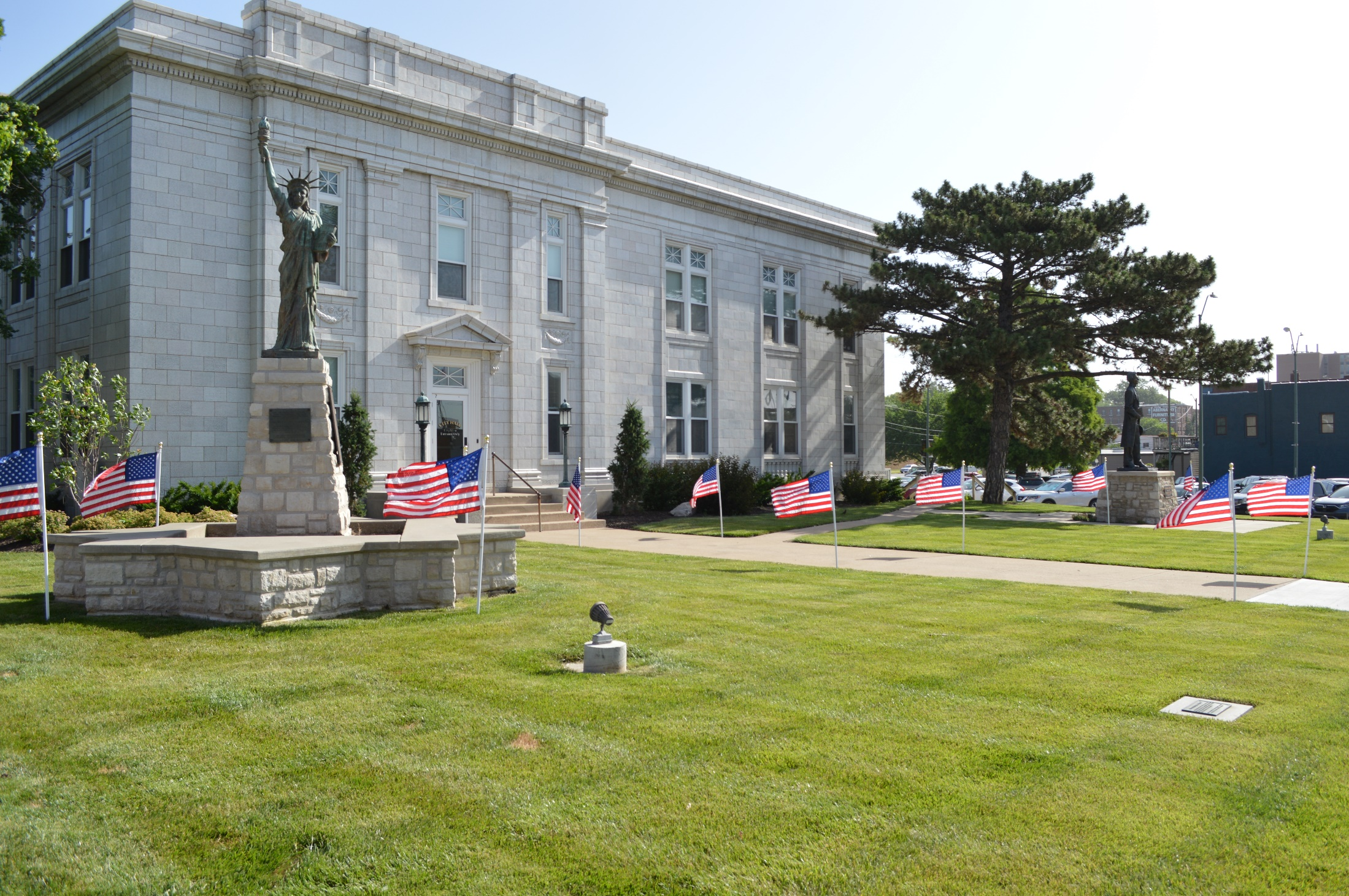
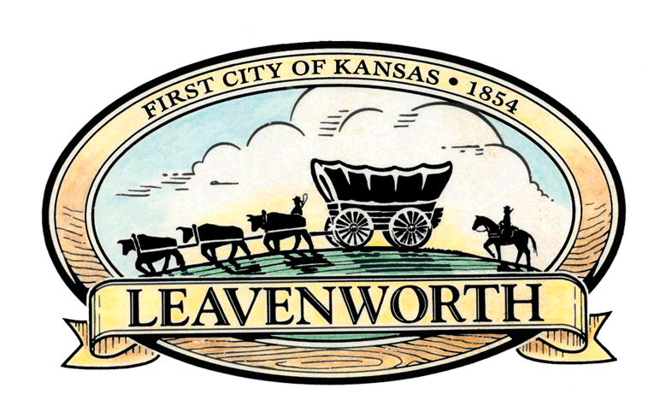
City of Leavenworth
Notes:
Photo of City Hall with American flags in the green grass, a miniature Statue of Liberty and Statue of Abraham Lincoln are on pedestals on the lawn. An image of the City of Leavenworth logo with a yellow ribbon and text reads “First City of Kansas 1854 Leavenworth”

Slide 2
City Challenge
One New Experience in the Community

Slide 3

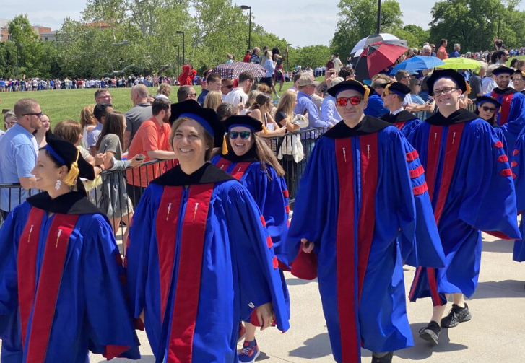

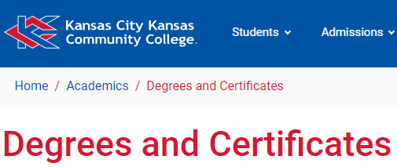
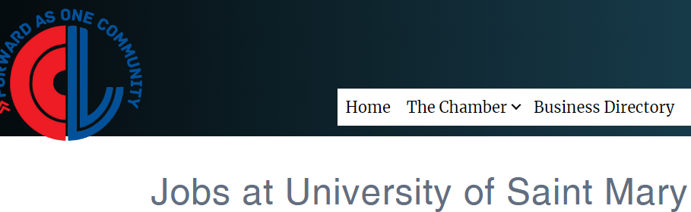


Academics and Work Opportunities
Notes:
6 images show: Website with City logo reads “Job openings” for city jobs, photo of blue and red graduation gowns and caps, photo clipping of Kansas City Kansas Community College with the text degrees and certificates, Indeed logo, K-State logo, Kansas University logo and Chamber logo

Slide 4
City Business Symposium
October 28, 2024
State and Local Officials
Kansas Leadership Center on Adaptive Leadership
K-State Innovation Center
Business Panel
Lunch Provided
www.LeavenworthKS.org/ED

Slide 5
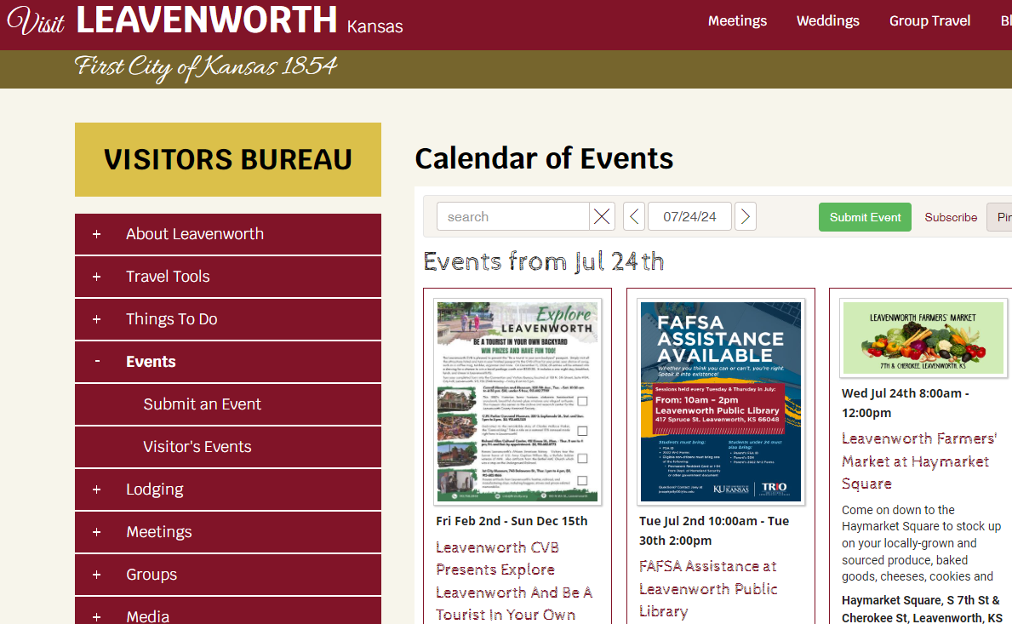
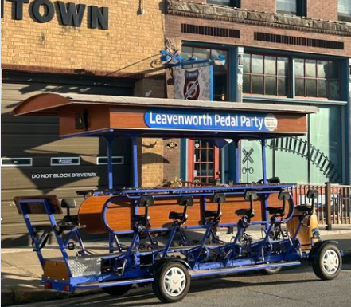

Events/Activities
www.VisitLeavenworthKS.com
www.Facebook.com/LeavenworthMainStreet
Notes:
Clipping of a Visit Leavenworth website which can be found at www.visitleavenworthks.com with a full events calendar of things to do in Leavenworth. Logo of Leavenworth Main Street.

Slide 6
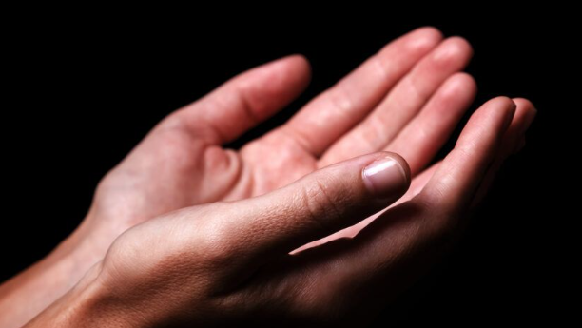
Places of Worship
Notes:
Photo of hands lifting up

Slide 7
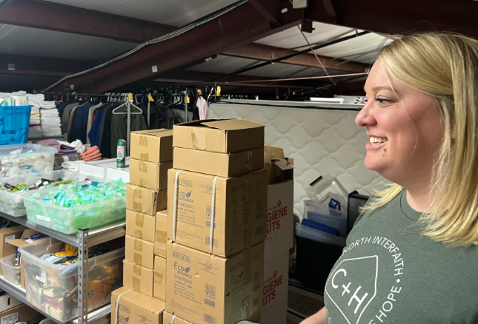
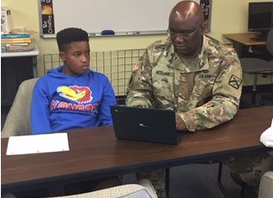
Volunteers
www.LVCommunityofHope.org
www.RichardAllenCulturalCenter.org
Notes:
Photo of woman standing near donated piles of boxes and mattress. Photo of man in military uniform sitting next to child reading computer screen.

Slide 8
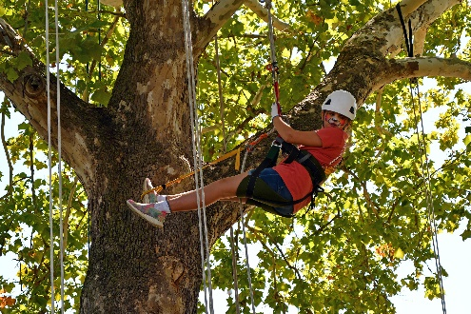
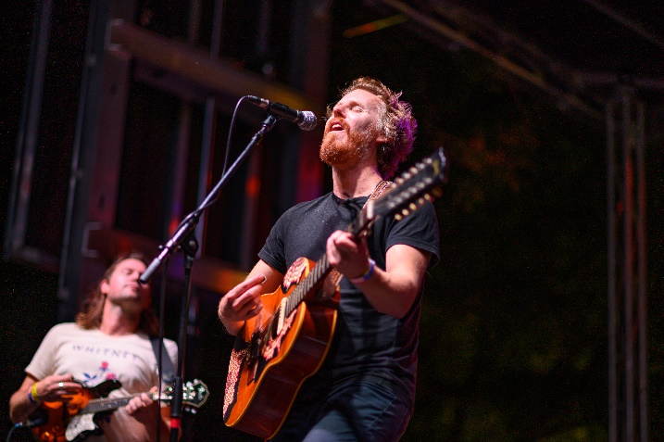
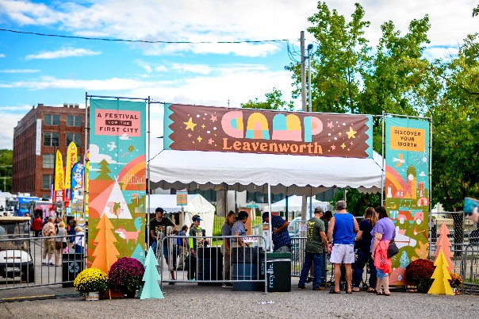
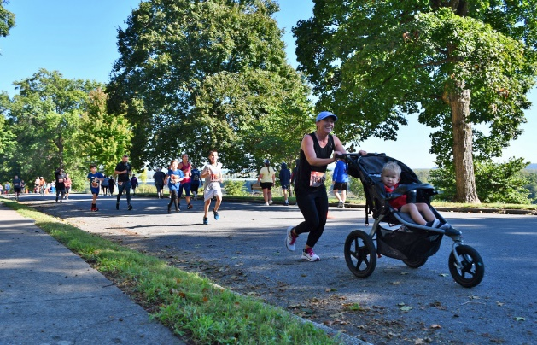
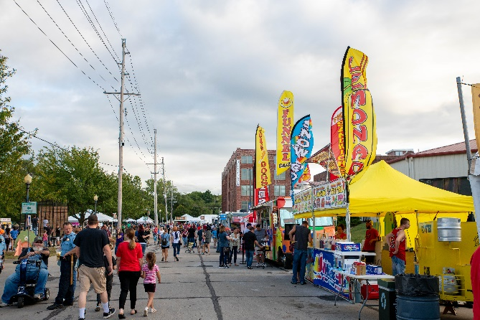
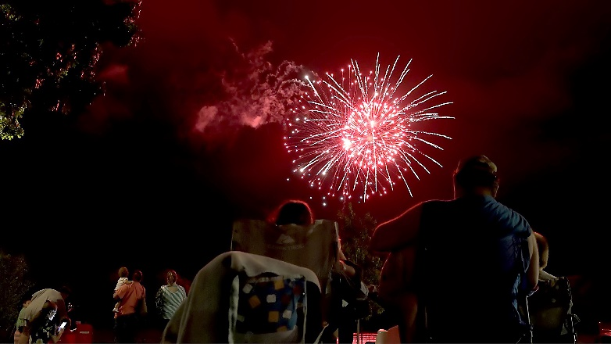
Camp Leavenworth
September 20-21
Notes:
Photo of music performer. Photo of tree climber. Photo of woman running with stroller. Photo of stage with a banner reading “Camp Leavenworth.” Photo of people walking around a parking lot with food vendors. Photo of people enjoying fireworks.

